Slide 1

Reefer Sanity:
Seven Great Myths About Marijuana
Kevin A. Sabet, Ph.D.
Director, Drug Policy Institute, University of Florida
Co-Founder, Project SAM (Smart Approaches to Marijuana)
www.learnaboutsam.org
www.kevinsabet.com

Slide 2
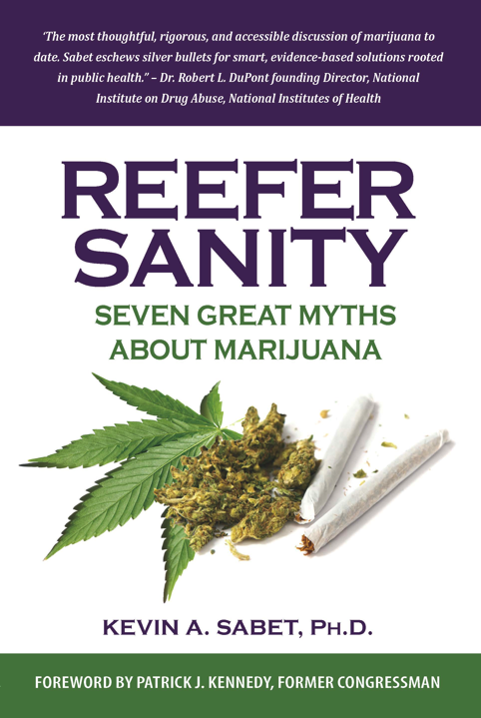


Slide 3
Trends in drug use
Current use among persons 12 and older: 2012
Alcohol
Tobacco
Marijuana
NSDUH, 2013

Slide 4
Myth 1:
Marijuana Is Harmless and Non-addictive

Slide 5
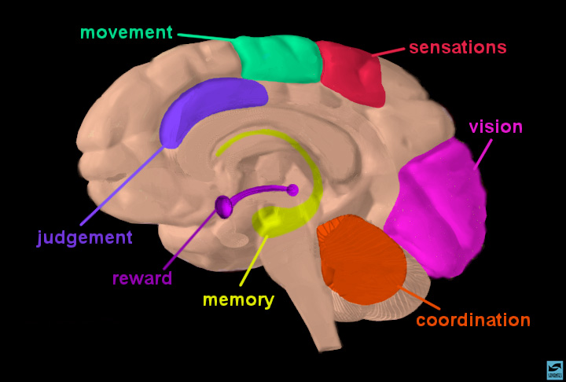
Cannabinoid Receptors Are Located Throughout the Brain and Regulate:
.
.
.
.
.
.
.
.
.
.
.
.
.
.
.
.
.
.
.
.
.
.
.
.
.
.
.
.
.
.
.
.
.
.
.
.
.
.
.
.
.
.
.
.
.
.
.
.
.
.
.
.
.
.
.
.
.
.
.
.
.
.
.
.
.
.
.
.
.
.
.
.
.
.
.
.
.
.
.
.
.
.
.
.
.
.
.
.
.
.
.
.
.
.
.
.
.
.
.
.
.
.
.
.
.
Brain Development
Memory and Cognition
Motivational Systems
& Reward
Appetite
Immunological Function
Reproduction
Movement Coordination
Pain Regulation
& Analgesia
.
.
.
.
.
.
.
.
.
.
.
.
.
.
.
.
.
.
.
.
.
.
.
.
.
.
.
.
.
.
.
.
.
.
.
.
.
.
.
.
.
.
.
.
.
.
.
.
.
.
.
.
.
.
.
.
.
.
.
.
.
.
.
.
.
.
.
.
.
.
.
.
.
.
.
.
.
.
.
.
.
.
.
.
.
.
.
.
.
.
.
.
.
.
.
.
.
.
.
.
.
.
.
.
.
.
.
.
.
.
.
.
.
.
.
.
.
.
.
.
.
.
.
.
.
.
.
.
.
.
.
.
.
.
.
.
.
.
.
.
.
.
.
.
.
.
.
.
.
.
.
.
.
.
.
.
.
.
.
.
.
.
.
.
.
.
.
.
.
.
.
.
.
.
.
.
.
.
.
.
.
.
.
.
.
.
.
.
.
.
.
.
.
.
.
.
.
.
.
.
.
.
.
.
.
.
.
.
.
.
.
.
.
.
.
.
.
.
.
.
.
.
.
.
.
.
.
.
.
.
.
.
.
.
.
.
.
.
.
.
.
.
.
.
.
.
.
.
.
.
.
.
.
.
.
.
.
.
.
.
.
.
.
.
.
.
.
.
.
.
.
.
.
.
.
.
.
.
.
.
.
.
.
.
.
.
.
.
.
.
.
.
.
.
.
.
.
.
.
.
.
.
.
.
.
.
.
.
.
.
.
.
.
.
.
.
.
.
.
.
.
.
.
.
.
.
.
.
.
.
.
.
.
.
.
.
.
.
.
.
.
.
.
.
.
.
.
.
.
.
.
.
.
.
.
.
.
.
.
.
.
.
.
.
.
.
.
.
.
.
.
.
.
.
.
.
.
.
.
.
.
.
.
.
.
.
.
.
.
.
.
.
.
.
.
.
.
.
.
.
.
.
.
.
.
.
.
.
.
.
.
.
.
.
.
.
.
.
.
.
.
.
.
.
.
.
.
.
.
.
.
.
.
.
.
.
.
.
.
.
.
.
.
.
.
.
.
.
.
.
.
.
.
.
.
.
.
.
.
.
.
.
.
.
.
.
.
.
.
.
.
.
.
.
.
.
.
.
.
.
.
.
.
.
.
.
.
.
.
.
.
.
.
.
.
.
.
.
.
.
.
.
.
.
.
.
.
.
.
.
.
.
.
.
.
.
.
.
.
.
.
.
.
.
.
.
.
.
.
.
.
.
.
.
.
.
.
.
.
.
.
.
.
.
.
.
.
.
.
.
.
.
.
.
.
.
.
.
.
.
.
.
.
.
.
.
.
.
.
.
.
.
.
.
.
.
.
.
.
.
.
.
.
.
.
.
.
.
.
.
.
.
.
.
.
.
.
.
.
.
.
.
.
.
.
.
.
.
.
.
.
.
.
.
.
.
.
.
.
.
.
.
.
.
.
.
.
.
.
.
.
.
.
.
.
.
.
.
.
.
.
.
.
.
.
.
.
.
.
.
.
.
.
.
.
.
.
.
.
.
.
.
.
.
.
.
.
.
.
.
.
.
.
.
.
.
.
.
.
.
.
.
.
.
.
.
.
.
.
.
.
.
.
.
.
.
.
.
.
.
.
.
.
.
.
.
.
.
.
.
.
.
.
.
.
.
.
.
.
.
.
.
.
.
.
.
.
.
.
.
.
.
.
.
.
.
.
.
.
.
.
.
.
.
.
.
.
.
.
.
.
.
.
.
.
.
.
.
.
.
.
.
.
.
.
.
.
.
.
.
.
.
.
.
.
.
.
.
.
.
.
.
.
.
.
.
.
.
.
.
.
.
.
.
.
.
.
.
.
.
.
.
.
.
.
.
.
.
.
.
.
.
.
.
.
.
.
.
.
.
.
.
.
.
.
.
.
.
.
.
.
.
.
.
.
.
.
.
.
.
.
.
.
.
.
.
.
.
.
.
.
.
.
.
.
.
.
.
Notes:
Slide 2: Brain regions and neuronal pathways
Certain parts of the brain govern specific functions. Point to sensory, motor, association and visual cortex to highlight specific functions. Point to the cerebellum for coordination and to the hippocampus for memory. Indicate that nerve cells or neurons travel from one area to another via pathways to send and integrate information. Show, for example, the reward pathway. Start at the ventral tegmental area (VTA) (in magenta), follow the neuron to the nucleus accumbens, and then on to prefrontal cortex. Explain that this pathway gets activated when a person receives positive reinforcement for certain behaviors ("reward"). Indicate that you will explain how this happens when a person takes an addictive drug.

Slide 6
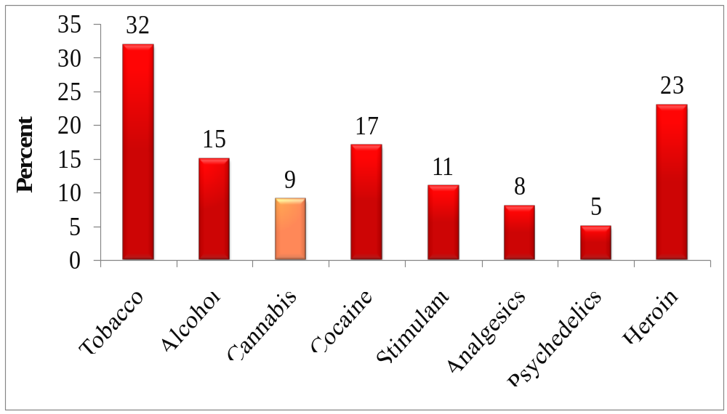
Addiction: About 9% of users may become dependent,
1 in 6 who start in adolescence and 25-50% of daily users
Estimated Prevalence of Dependence Among Users
*
* Nonmedical Use Source: Anthony JC et al., 1994
*
American Psychiatric Association’s Diagnostic Manual (DSM) has included marijuana use disorders since 1980.
DSM-5 added Marijuana Withdrawal as a diagnosis.

Slide 7
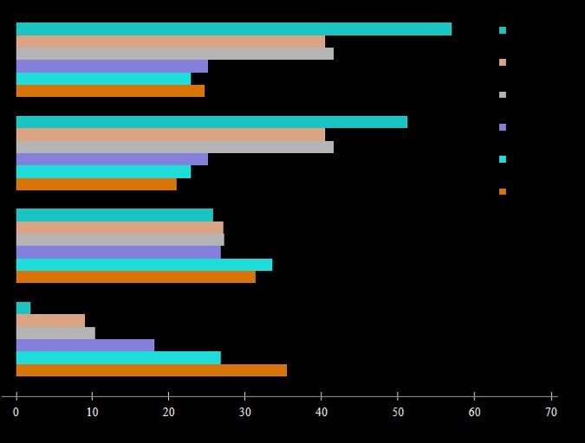
More Use of Cannabis Associated with Worse
Social Outcomes at Age 25 (New Zealand Study)
400+
300 to 399
200 to 299
100 to 199
1 to 99
Never
% welfare dependent
(ages 21-25)
% Unemployed
(ages 21-25)
mean personal income
in thousands of NZ $
at age 25
% gained university degree
by age 25
# of occasions using
Cannabis ages 14-21
Number of occasions using
Cannabis between ages 14-21
Source: Fergusson and Boden. Addiction, 103, pp. 969-976, 2008.
Notes:
Marijuana use is strongly linked to poorer outcomes later in life.
The relationship between marijuana use and poor life outcomes appears to be dose dependent. Illustrated are the results of a 25-year longitudinal study of a New Zealand birth cohort showing associations between increasing levels of cannabis use at ages 14-21 and: higher levels of welfare dependence; higher unemployment; lower income at age 25; and lower levels of academic degree attainment by age 25.
These results are consistent with an earlier study in the US showing poorer outcomes for chronic marijuana users in terms of education attained, household income, and overall life satisfaction. (Gruber, AJ et al., Psychological Medicine, 33, pp. 1415-1422, 2003.)

Slide 8
Cannabis-Associated Psychosis
CANNABIS AND SCHIZOPHRENIA
Study of Swedish Conscripts (n=45570)
CANNABIS AND SCHIZOPHRENIA-Like Longitudinal prospective Dunedin study (n=1037)
Cases of Sz
per 1,000
Risk of schizophrenia-like
psychosis at age 26 years
30
20
Odds ratio
10
0
0
1
2
10
<50
>50
No of times cannabis taken
Andréasson et al Lancet, 1987.
Arseneault et al BMJ 2002

Slide 9
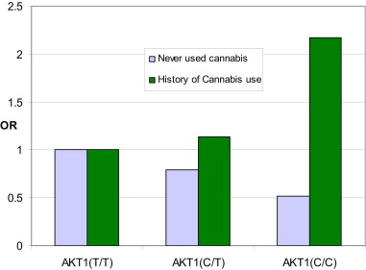
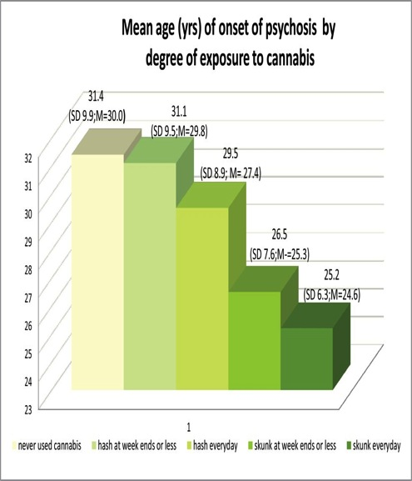
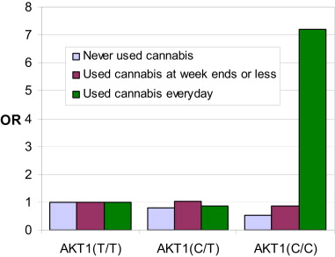
Regular Cannabis Use Increases Schizophrenia Risk in those with AKT1 rs2494732 genotype
High Potency Cannabis and Earlier Onset of Psychosis
Never used cannabis
History of cannabis use
Odds Ratio
31.4
31.1
29.5
AKT1(T/T) AKT1(C/T) AKT1(C/C)
26.5*
Never used cannabis
Used cannabis at week ends or less
Used cannabis everyday
Odds Ratio
25.2*
AKT1(T/T) AKT(C/T) AKT1(C/C)
None
≤
Weekly
Hash
Daily
Hash
≤
Weekly
Skunk
Daily
Skunk
AKT1 genotype does not predict History of Cannabis use (p=0.772) GXE multiplicative model: p*=0.014
Di Forti et al., Biological Psychiatry, 2012.
Di Forti M et al. Schizophr Bull 2013;schbul.sbt181

Slide 10
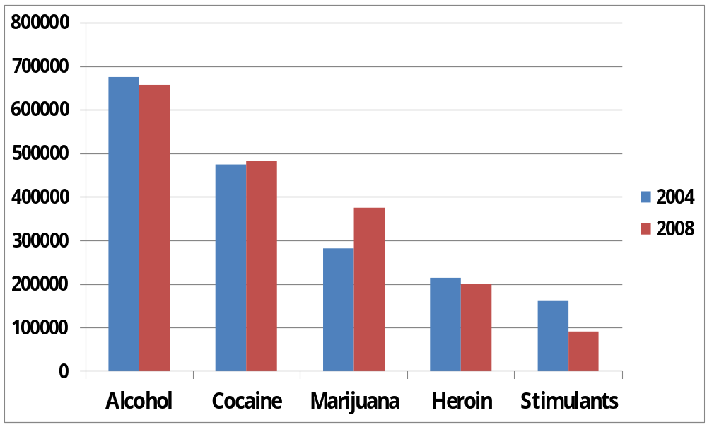
Emergency Department Visits Involving Selected Drugs: 2008
Source: SAMHSA, 2008 DAWN.

Slide 11





Increased Potency
Today’s marijuana is not the marijuana of the 1960s.
In the past 15 years, marijuana potency has tripled and since 1960 it grown 5 times stronger.

Slide 12
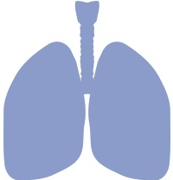
Harmful effects on the lungs
Research shows that marijuana smoke is an irritant to the lungs.
Results in greater prevalence of:
  bronchitis,
  cough,
  and phlegm production.
Tetrault, J.M, 2007

Slide 13
Marijuana smoke is carcinogenic.
It contains 50-70 percent more carcinogenic hydrocarbons than tobacco smoke.
Evidence linking marijuana and cancer is mixed. However, marijuana smoke contains an enzyme that converts hydrocarbons into a cancer-causing form.
Evidence on cancer is mixed.
Hoffman, D., et al., 1975; Brambilla, C., & Colonna, M., 2008; Bello, D., 2006; Tashkin, D. P., 1999

Slide 14
Marijuana use has significant effects on IQ and learning
Persistent and heavy use among adolescents reduces IQ by 6-8 points
According to a government survey, youth with poor academic results are more than four times likely to have used marijuana in the past year than youth with an average of higher grades.
Meier, M.H., et al., 2012; MacLeod, J., et al., 2004.

Slide 15
Myth 2:
Smoked/Eaten Marijuana is Medicine

Slide 16
Is marijuana medicine?
Marijuana has medical properties, BUT we don’t need to smoke or eat it!
We don’t smoke opium to derive the benefits of morphine.
So we don’t need to smoke marijuana to receive it’s potential benefits.
A distinction must be made between raw, crude marijuana and marijuana’s components

Slide 17
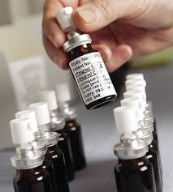
Marijuana-based medicines
Marinol (synthetic THC)
Sativex® in Brazil
THC:CBD = 1:1
It is administered via an oral mouth spray
Already approved in Canada and Europe
Also Epidiolex ®, pure CBD, no THC

Slide 18
Myth 3:
Countless People Are Behind Bars for Smoking Marijuana

Slide 19
Bureau of Justice Statistics, 2004

Slide 20
Myth 4:
The Legality of Alcohol and Tobacco Strengthen the Case for Marijuana Legalization

Slide 21
Alcohol and Tobacco: A Model?
Use levels for alcohol and tobacco are much higher than marijuana
Industries promote addiction and target kids
Schiller JS, Lucas JW, Peregoy JA. Summary health statistics for U.S. adults: National Health Interview Survey, 2011. National Center for Health Statistics. Vital Health Stat 10(256). 2012.
Centers for Disease Control and Prevention. Vital Signs: Current Cigarette Smoking Among Adults Aged ≥ 18 Years—United States, 2005–2010. Morbidity and Mortality Weekly Report 2011;60(33):1207–12

Slide 22
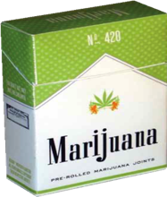
‘Big marijuana’
Can we trust companies and Big Corporations not to target youth and the vulnerable?

Slide 23
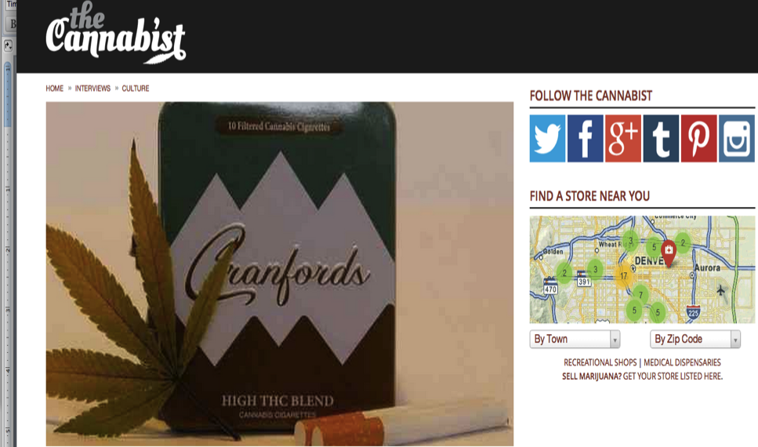

Slide 24



Slide 25
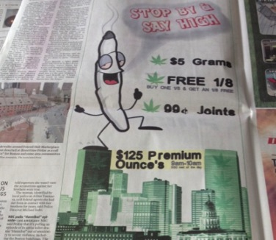
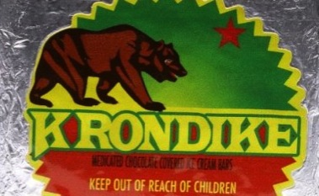
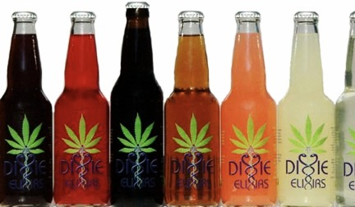

Slide 26
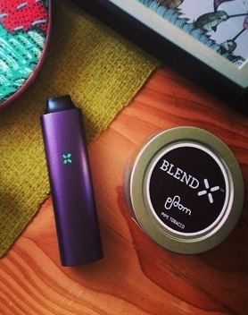
Vaporizing industries:
Nicotine and Marijuana
Pax by Ploom
Japan Tobacco International (JTI) is the third largest international tobacco company behind Philip Morris International.
In 2011, JTI bought a portion of Ploom – a startup based in Silicon Valley that produces a loose-leaf vaporizer that can be used to inhale heated vapor from marijuana as well as tobacco, called the Pax.

Slide 27
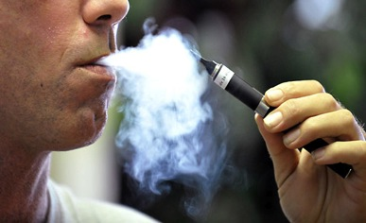
Regular E-Cigarettes can be used to vaporize marijuana
Marijuana with THC concentrates approaching 100%, in the form of butane-extracted hash oil (BHO) can easily be packed into e-cigarettes.
The process is extremely dangerous.
E-cig companies are increasingly marketing youth and adolescents.
Teen use of e-cigarettes is significantly on the rise.

Slide 28
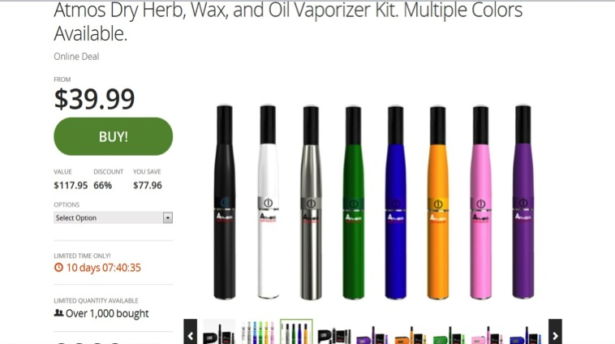
M-Cigarettes
(marijuana vaporizers) – Brought to you by Groupon!

Slide 29


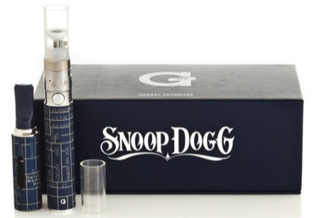

Increasingly popular and accessible

Slide 30
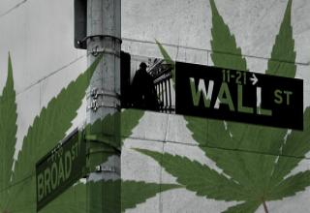

Slide 31
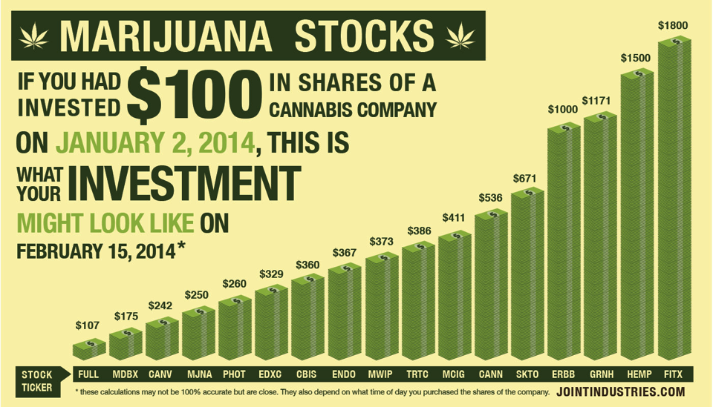


Slide 32
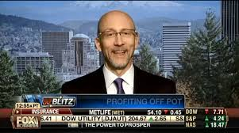

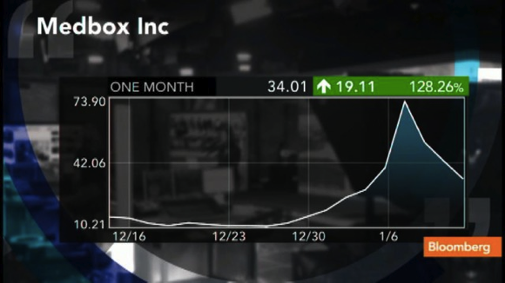

Slide 33

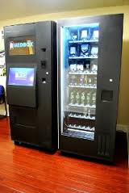

Slide 34
‘Big marijuana’
“The use of marijuana ... has important implications for the tobacco industry in terms of an alternative product line. [We] have the land to grow it, the machines to roll it and package it, the distribution to market it. In fact, some firms have registered trademarks, which are taken directly from marijuana street jargon. These trade names are used currently on little-known legal products, but could be switched if and when marijuana is legalized. Estimates indicate that the market in legalized marijuana might be as high as $10 billion annually.”
From a report commissioned by cigarette manufacturer Brown and Williamson (now merged with R.J. Reynolds) in the 1970s.

Slide 35
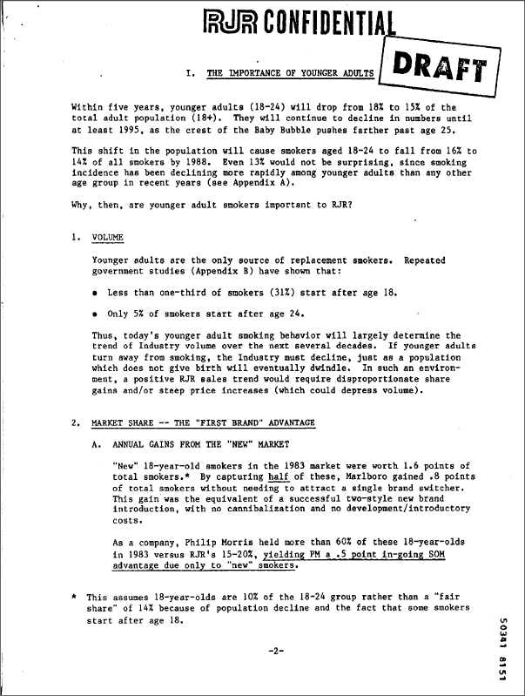
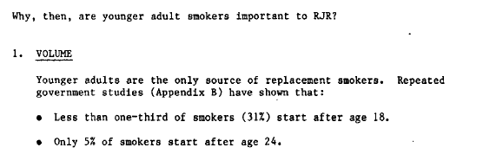
R.J.Reynolds, 1984 est.: http://legacy.library.ucsf.edu/tid/eyn18c00

Slide 36
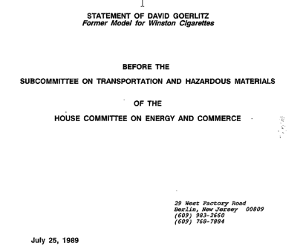
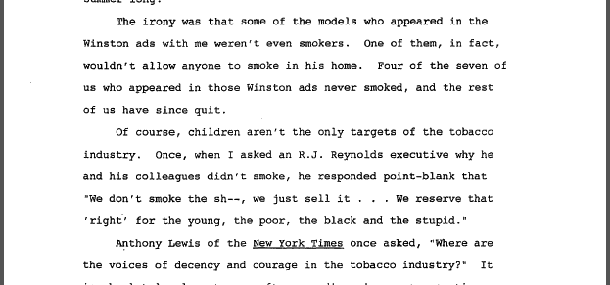
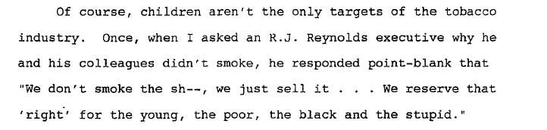
Tobacco Institute, 1989: http://legacy.library.ucsf.edu/tid/pvt37b00

Slide 37
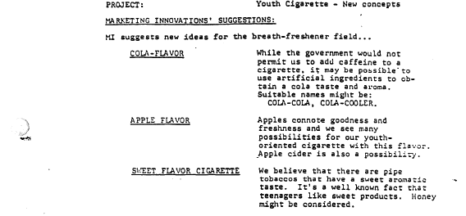
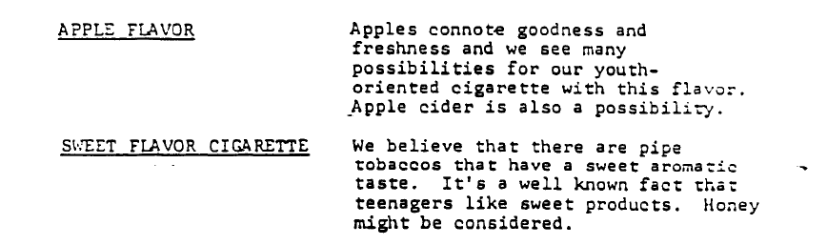
Brown and Williamson, 1972: http://legacy.library.ucsf.edu/tid/wwq54a99

Slide 38
Will Big Marijuana become the new Big Tobacco?

Slide 39
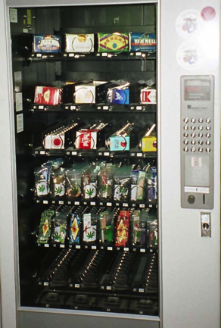
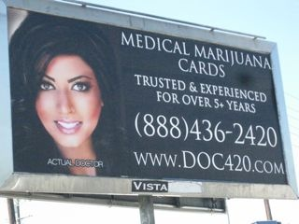
Several vending machines and billboards have already emerged throughout the country

Slide 40
Will legalization diminish the power of cartels and the black market?
Marijuana accounts for 15-25% of revenues gained from drug trafficking groups
More money is found in human trafficking, kidnapping, and other illicit drugs
Kilmer, B., et al., 2010

Slide 41
Will legalization diminish the power of cartels and the black market?
In a legal market, where drugs are taxed and regulated (for instance to keep THC potency below a certain level or to prevent sale to minors), the black market has every incentive to remain
Legalizing marijuana would not deter these groups from continuing to operate
Kilmer, B., et al., 2010

Slide 42
Myth 5:
Legal Marijuana Will Solve the Government’s Budgetary Problems

Slide 43
Alcohol & Tobacco:
Money Makers or Dollar Drainers?
Alcohol Costs
T obacco Costs
$185
billion
$200
billion
Costs
$14 billion
$25 billion
Revenues
Revenues
State estimates found at http://www.nytimes.com/2008/08/31/weekinreview/31saul.html?em; Federal estimates found at https://www.policyarchive.org/bitstream/handle/10207/3314/RS20343_20020110.pdf; Also see http://www.tobaccofreekids.org/research/factsheets/pdf/0072.pdf; Campaign for Tobacco Free Kids, see “Smoking-caused costs,” on p.2.

Slide 44
Myth 6:
Portugal and Holland Provide Successful Examples of Legalization

Slide 45
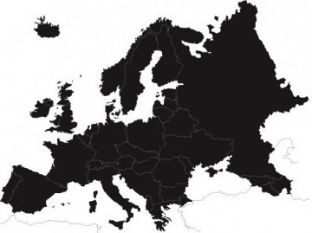
Neither Holland nor Portugal have legalized ANY drug

Slide 46
Myth 7:
Prevention, Intervention, and Treatment are Doomed to Fail – So Why Try?

Slide 47
How did we get here?

Slide 48
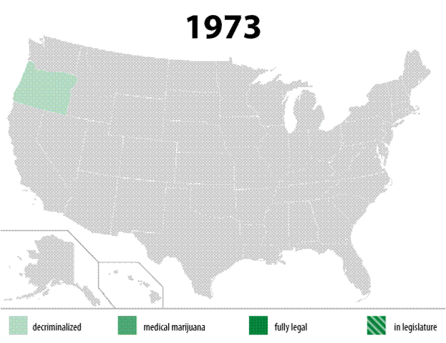
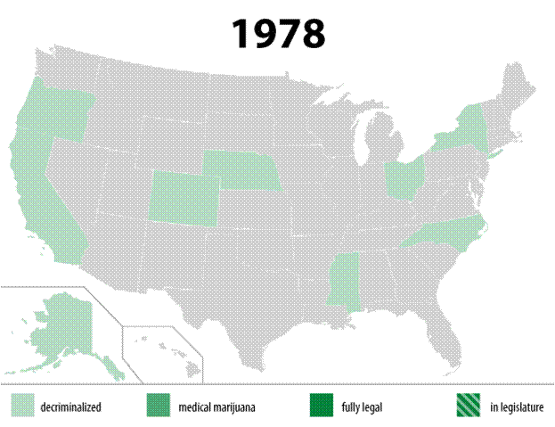
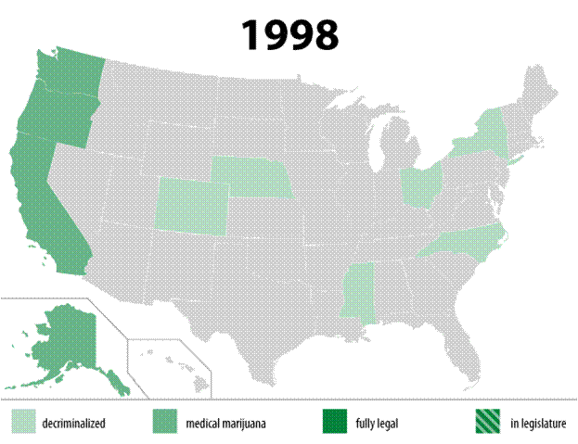
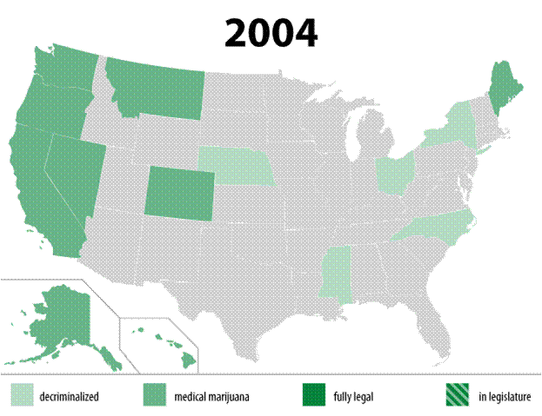
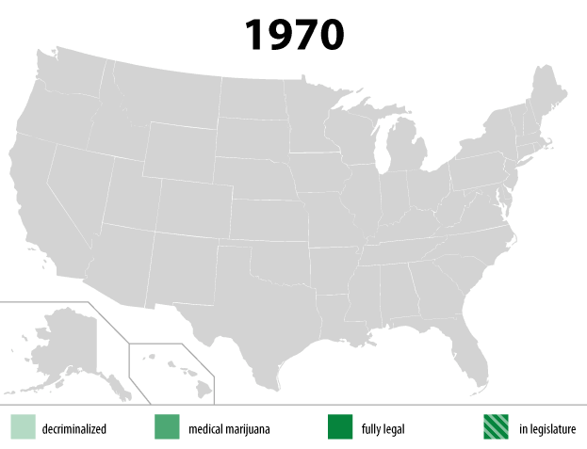
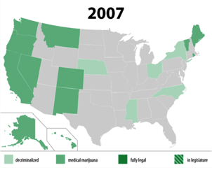
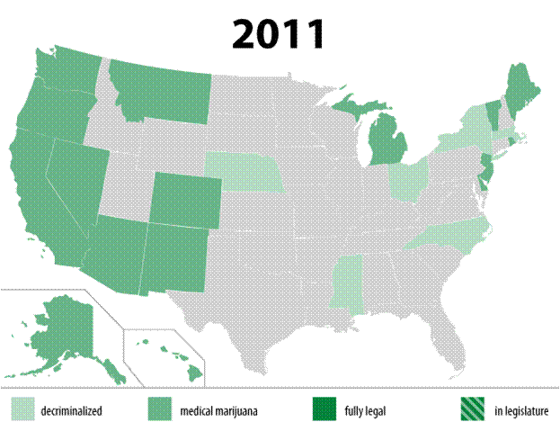
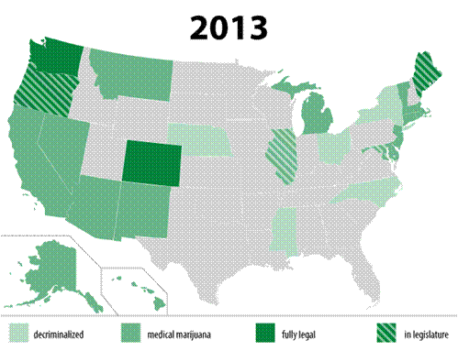
Changes in Marijuana Policy in the USA
Notes:
Factors associated with marijuana use have been undergoing dramatic changes. The potency, sources, availability, public perception, legal status, and patterns of use are significantly different than when marijuana use became a national issue more than 40 years ago. Public opinion around marijuana for medical or recreational purposes has become increasingly positive and permissive, despite the dearth of scientific data reinforcing therapeutic benefit or knowledge of longer term outcomes among exposed children and adolescents and even adults.
We see here how rapidly at least the policy environment is changing, and while we have to date seen modest increases in prevalence we should anticipate continued trajectory of use and attitudes and we need to know how are all of these changes going to impact public health outcomes.

Slide 49
Medical Marijuana
“We will use [medical marijuana] as a red-herring to give marijuana a good name.”
—Keith Stroup, head of NORML to the Emory Wheel, 1979
Emory Wheel Entertainment Staff, 6 February 1979

Slide 50
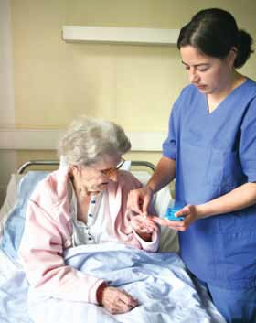

Only a small proportion of medical marijuana users report any serious illness
Less than 2% report cancer, HIV/AIDS, glaucoma, MS, Crohn’s, ALS, etc. as their reason for using medical marijuana.
Profile: 30s white male, no history of cancer/AIDS. Self-reported back pain
Sabet, K. (2014) submitted
Nunberg et al. (2011).

Slide 51
Legalization – Follow the Money

Slide 52
Colorado
and
Washington

Slide 53
Colorado Didn’t Legalize Overnight
2001
2005
2007-8
2009
2012
2014
1st stores
Legalized
Denver legalizes possession
700 stores
3.5% adults have MMJ license
Recreational Stores open
Medical Marijuana in Colorado
Nussbaum et al., Am J Psychiatry 168:778-781

Slide 54
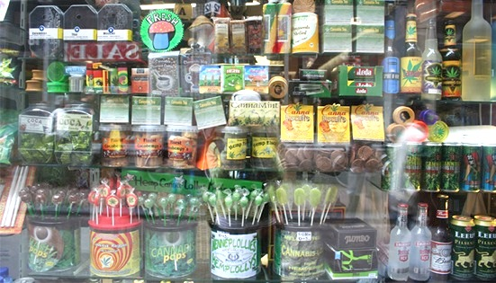
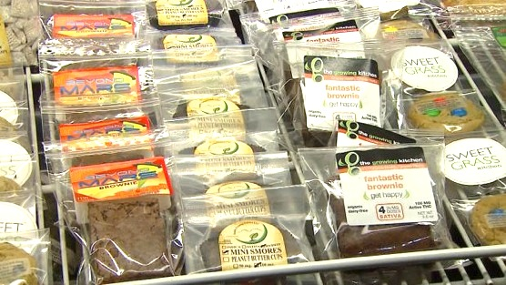
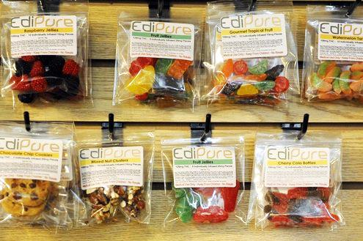
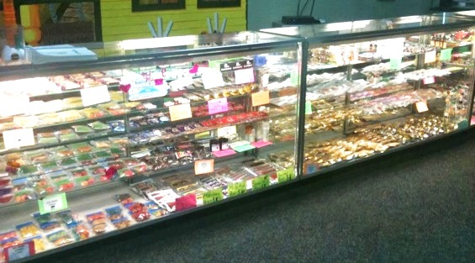
Marijuana Edible Displays

Slide 55
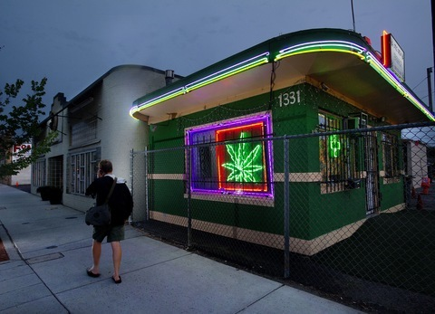
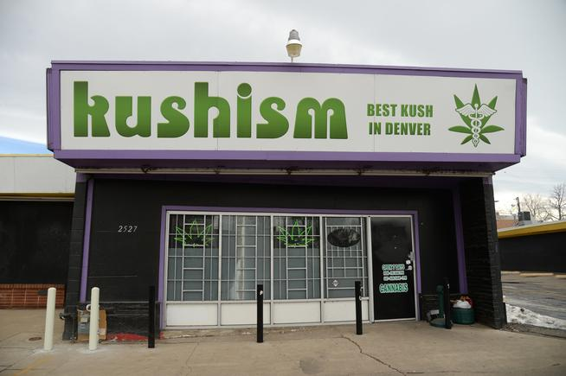
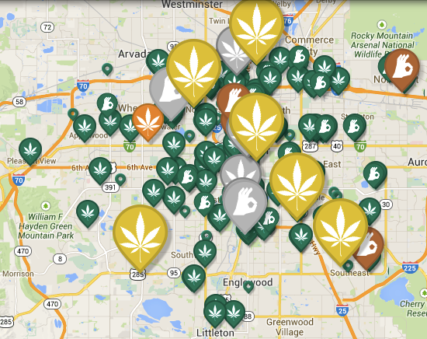


Slide 56



Slide 57


Slide 58


Slide 59

“Dot-bong” Era Begins:
Seattle’s Yale MBAs
Creators of
Privateer Holdings:
The first equity company
dedicated to the
marijuana industry.

Slide 60

Big MJ benefits from eroding healthy norms
“In This Issue…”
Community branding
Marijuana delivered to your door
Sex and pot advice
E-joint trend
Gummy bears

Slide 61
















Slide 62


Slide 63


Slide 64
Source of Marijuana* among 12th Graders in 2012 and 2013, by State Policy
*Categories not mutually exclusive
** Statistically significant difference
Notes:
B021. Where did you get the marijuana you used during the last year? (Mark all that apply)
Overall 3.1% said they got their mj from own mmj prescription- split to 5.5 in mmj state vs 1.6 in non-mmj state (?).
B021a. Did you get any of the marijuana you used during the last year from someone else's medical marijuana prescription?
Overall 18.4% said they got the mj they used from someone else’s prescription – over 1/3 of those in mmj states said yes to this question compared to less than 9% in non-mmj states

Slide 65

States that Legalized Marijuana Use For Medical Purposes Have Significantly Higher Rates Of Marijuana Use and of Marijuana Abuse and Dependence
Map of States that Legalized
Medical Marijuana by 2004
Odds Ratio
passed laws legalizing
medical MJ
  NESARC: National Epidemiologic Survey on Alcohol and Related Conditions
Cerda M et al. Drug and Alcohol Dependence 2012; 120: 22 – 27.

Slide 66


Proportion Of Fatal Crash Drivers MJ-Positive In Colorado and
34 States Without Medical MJ, 1994-2011
Proportion of MJ Positive Drivers (%)
Date of widespread Medical MJ implementation in Colorado (2009)
Year
Salomonsen-Sautel S et al., Drug and Alcohol Dependence 2014.

Slide 67

Traffic Fatalities + for Marijuana
%
Salomonsen-Sautel S, Min SJ Sakai JT, Thurstone C, Hopfer C.Trends in fatal motor vehicle crashes before and after marijuana commercialization in Colorado. Accepted for publication in Drug and Alcohol Dependence

Slide 68

Latest CO data shows youth use at 10-yr high
Marijuana stores/commercialization flourish in CO

Slide 69

Urinary THC/Cr - adolescents in substance treatment
p<0.01
479
THC/Cr
361
Belendiuk et al (2013), The effect of marijuana commercialization on adolescent drug treatment outcomes, AACAP Poster Presentation, Orlando, FL

Slide 70

Childhood Exposures
of 1378 unintentional toxic ingestions to Children’s Hospital Colorado
p<0.001
14/588
# toxic exposures
0/790
Wang et al., (2013), JAMA Pediatr 167:630-633

Slide 71

  Increased teen use
Marijuana use among Colorado teens is currently:
fifth highest in the nation
50% above national average
10.7%
Colorado
7.6%
NSDUH, 2013
National average

Slide 72
Distribution to minors
Drug-related referrals for high school students testing positive for marijuana increased
Average of 17.3% per year between 2010 to 2012
Rose by over 150%
Average 5.6% of students per year between 2007 and 2009
Rocky Mountain HIDTA, 2013
Notes:
colorado

Slide 73
  Medical marijuana is easily diverted to youth
Teens who know somebody with a medical marijuana license are more like than those who don’t to report ‘fairly’ or ‘very’ easy access to marijuana
74% of Denver-area teens in treatment said they used somebody else’s medical marijuana an average of 50 times
Thurstone, 2013; Salomonsen-Sautel et al., 2012

Slide 74

  Denver high schools
29% of Denver high school students used marijuana in the last month
If Denver were an American state, it would have the HIGHEST public high school current use rates in the country
Healthy Kids Colorado, 2012

Slide 75
While the total number of car crashes declined from 2007 to 2011, the number of fatal car crashes with drivers testing positive for marijuana rose sharply.
Crashes with high drivers
Colorado Dept of Transportation

Slide 76

Hospital Cannabis Discharge DX
#
Source: Colorado Department of Public Health and the Environment

Slide 77
Early Indications in Colorado
When asked, 10% of non-using youth said they would use, according to 10,000-student survey by NYU researcher, published in peer-reviewed journal (Palamar et al, International Journal of Drug Policy)
“Students Find Way to Sneak Marijuana Into Class”
“Colorado students who ingested marijuana edibles treated at hospital”
“Marijuana candy at Colorado middle school”
“Colorado pot trade is smoking Nebraska Panhandle budgets”
“Marijuana superstore proposed in Eagle, Colorado”

Slide 78






CAN YOU TELL THE DIFFERENCE?
NEITHER CAN YOUR KIDS.

Slide 79

79

Slide 80
Responsible Regulations?
Heavily influenced by CO’s massive medical marijuana industry
Advertising allowed in magazines/newspapers where 21+ makes up “more than 30% of audience”

Slide 81
Projected vs. Actual Tax Revenue
(in millions)

Slide 82
2014 Marijuana Developments
Associated Press: “Two Denver Deaths Linked to Recreational Marijuana Use”. One includes the under-aged college student who jumped to his death after ingesting marijuana cookie.
The number of parents calling the poison-control hotline to report their kids had consumed marijuana has risen significantly in Colorado.
Marijuana edibles and marijuana vaporizers have been found in middle and high schools.

Slide 83

Colorado’s underground market
A Colorado drug dealer says that if anything, legalization has helped his business because “it’s over priced, it’s being taxed way too high.”

Slide 84
Colorado’s underground market
Colorado Springs Lieutenant stated that “[Legalization] has done nothing more than enhance the opportunity for the black market. If you can get it tax-free on the corner, you’re going to get it on the corner.”

Slide 85
Overall in CO
Tax revenue LOWER than expectations
Higher use & car crashes since 2008-2009 sales began
Edible companies and lobbying groups on the rise since 2012 passage of legalization

Slide 86
Bipartisan Co-Chairs (Kennedy + Frum)
Launch 2013
Over 50,000 press mentions
Public Health Scientific Advisory Board
24 state-wide affiliates

Slide 87
  Project SAM
To inform public policy with the science of today’s marijuana.
To have honest conversations about reducing the unintended consequences of current marijuana policies, such as lifelong stigma due to arrest.
To prevent the establishment of Big Marijuana that would market marijuana to children — and to prevent Big Tobacco from taking over Big Marijuana. Those are the very likely results of legalization.
To promote research of marijuana’s medical properties and produce pharmacy-attainable medications.

Slide 88


Slide 89




1964:
DESPITE:
Today:
DESPITE:
Marijuana is medicine/safe:
“…cannabis is a dangerous drug and as such is a public health concern...the sale of cannabis should not be legalized.” - American Medical Association (AMA)
WHO WILL WE LISTEN TO THIS TIME?

Slide 90



Slide 91
Thank you – for listening!
kevin@learnaboutsam.org
www.learnaboutsam.org
www.kevinsabet.com
www.legalizationviolations.com

